Slide 1
Digital Portfolio
STUDENT NAME: SRUTHI K M
REGISTER NO AND NMID: 2428B0355
DEPARTMENT: B.Sc. COMPUTER SCIENCE WITH DATA ANALYTICS
COLLEGE:KPR COLLEGE OF ARTS SCIENCE AND RESEARCH

Slide 2
PROJECT TITLE :
VOLUNTEERING IN COLLEGE EVENTS

Slide 3


AGENDA
Problem Statement
Project Overview
End Users
Tools and Technologies
Portfolio design and Layout
Features and Functionality
Results and Screenshots
Conclusion
Github Link
3/21/2024 Annual Review

Slide 4

PROBLEM STATEMENT
Organizing college events requires many volunteers, but current manual methods (sign-up sheets, WhatsApp, emails) are inefficient. Challenges include:
Missed updates & poor communication
Uneven workload & last-minute shortages
Random task assignments without considering skills
No proper tracking or recognition of contributions
Solution: A Volunteering Management System that:
Matches volunteers to roles based on skills & interests
Sends real-time notifications & updates
Manages shifts and replacements dynamically
Tracks participation and provides certificates / recognition
Collects feedback & analytics to improve future events

Slide 5

PROJECT OVERVIEW
A web-based platform to efficiently manage volunteers for college events. Organizers can assign tasks, track participation, and communicate instantly, while volunteers can choose roles, receive updates, and earn recognition.

Slide 6

WHO ARE THE END USERS?
Students / Volunteers: Can register, select roles, and track their contributions.
Event Organizers: Can plan events, assign tasks, monitor volunteers, and communicate effectively.
College Admins: Can analyze participation, generate reports, and improve future events.

Slide 7

TOOLS AND TECHNIQUES
Frontend: HTML, CSS, JavaScript, Bootstrap
Backend: Java / Python / Node.js
Database: MySQL / MongoDB
Notifications: Email & Push Notifications
Version Control: Git & GitHub

Slide 8
POTFOLIO DESIGN AND LAYOUT
Clean, minimalistic interface with clear navigation
Dashboard for organizers and volunteers
Color-coded tasks & volunteer status
Responsive design for desktop and mobile
Visual analytics (charts, progress bars) for tracking participation
8

Slide 9
FEATURES AND FUNCTIONALITY
Volunteer registration & profile management
Event creation & skill-based task assignment
Real-time notifications and updates
Shift management and replacement system
Participation tracking & certificate generation
Feedback collection & analytics dashboard

Slide 10
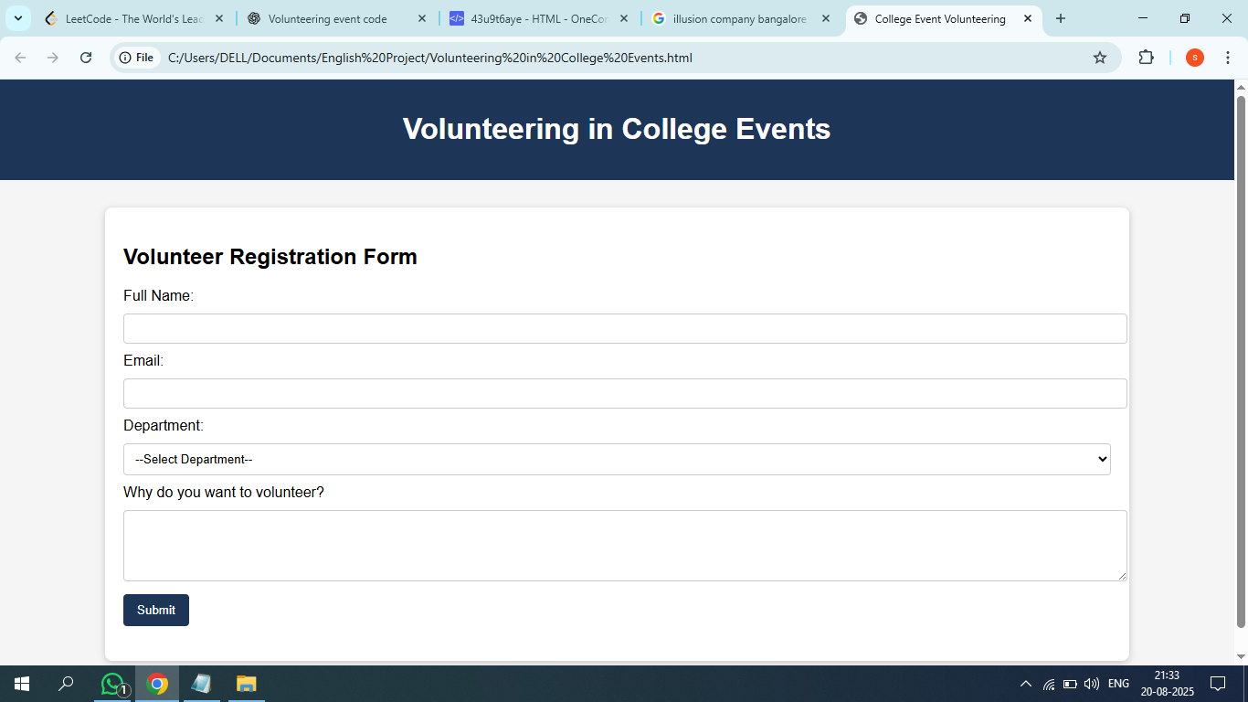

RESULTS AND SCREENSHOTS
3/21/2024 Annual Review
10

Slide 11
CONCLUSION
This system simplifies volunteer management, ensures smooth event execution, and encourages student participation with recognition and feedback, making college events more successful and organized.
11

Slide 12
GITHUB LINK :
https://sruthimuthusamy2006-cpu.github.io/Sruthi05/

